Slide 1
Mouse Kidney Glomerulus Classification
Sarah Suet Ling Chow, Bingxin Huang,
Jack Chun Kit Kot
Translational and Advanced Bioimaging Laboratory (TAB)
Department of Chemical and Biological Engineering (CBE)
The Hong Kong University of Science and Technology (HKUST)

Slide 2
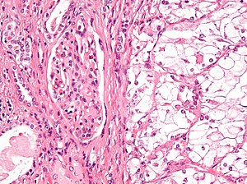
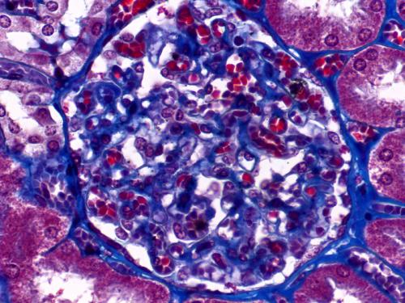
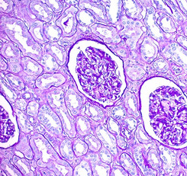
Essential of Glomerulus Classification
H&E
Trichrome
PAS
Autonomously classifying different types of cells in a histological image can aid pathologists in accomplishing the arduous task.
An accurate tissue classifier can help researchers in the biomedical field be more effective when processed with raw data

Slide 3
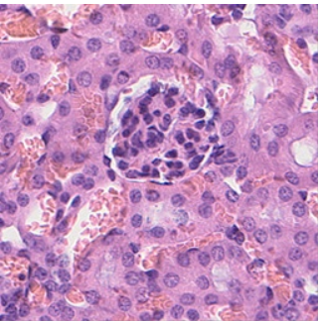
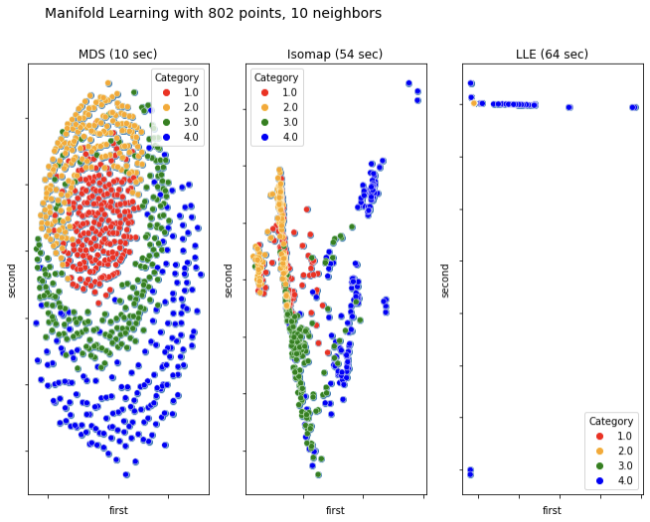
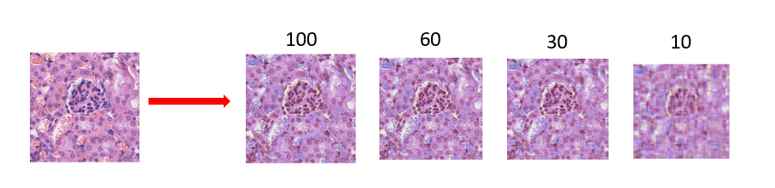
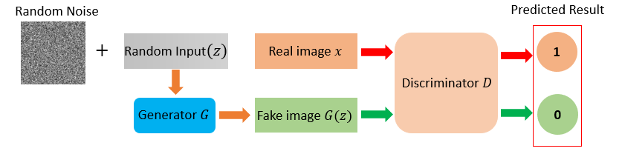
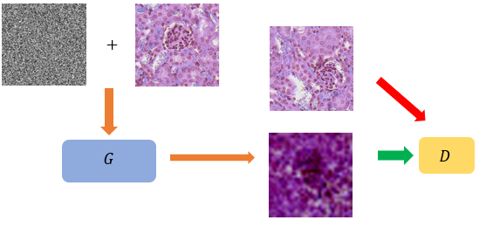
Dataset
Part I: Manifolding Learning Method
MDS + Isomap + LLE
HE with glomerulus
Training: 200
Testing: 20
HE without glomerulus
Training: 200
Testing: 20
Part II: AlexNet
PCA
DCGAN
PCA + DCGAN
MT with glomerulus
Training: 191
Testing: 20
MT without glomerulus
Training: 212
Testing: 20

Slide 4
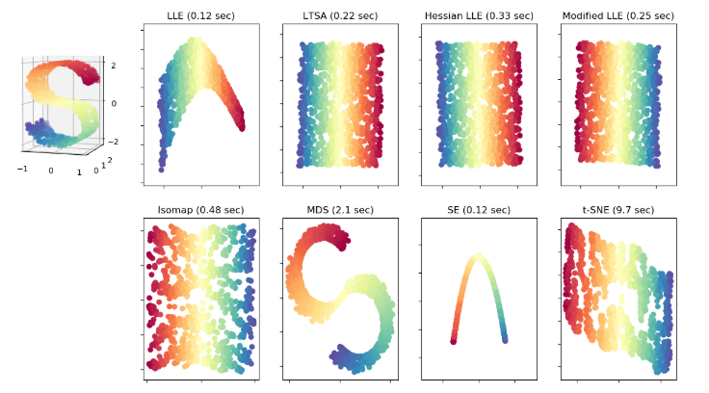
Manifold Learning Methods
Manifold learning
Multidimensional Scaling (MDS)
Isometric Mapping (ISOMAP)
Locally Linear Embedding (LLE)
Recover the low-dimensional manifold structure from the high-dimensional sampled data
Achieve dimensional reduction and data visualization

Slide 5
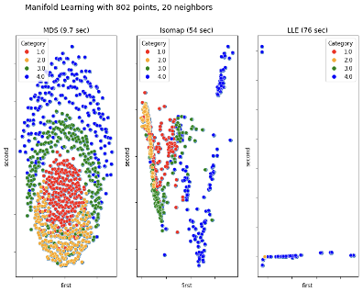
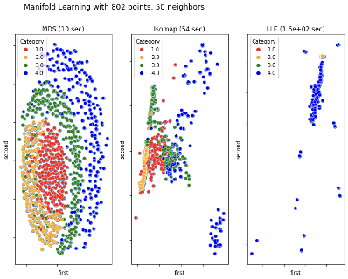
Manifold Learning Methods (Result)
 | 10 | 20 | 50
MDS | 10 sec | 9.7 sec | 10 sec
Isomap | 54 sec | 54 sec | 54 sec
LLE | 64 sec | 76 sec | 160 sec
10 Neighbors
20 Neighbors
50 Neighbors
MDS can classify four classes with a fast speed even by different neighbors.
Isomap has a variable performance on classification despite required time is stable.
LLE cannot classify while the required time increases along with epochs.

Slide 6



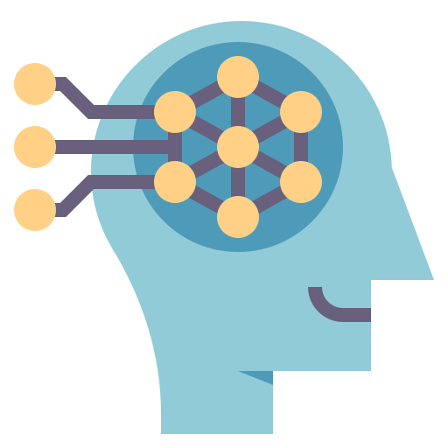

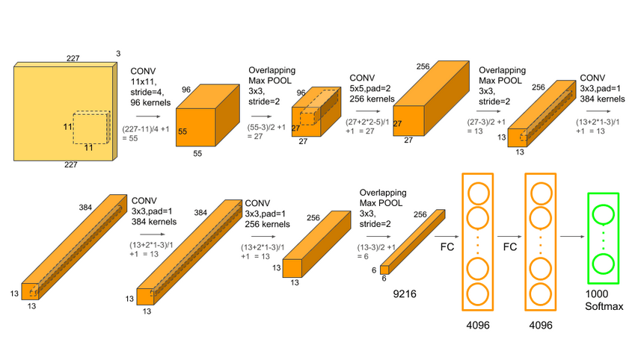
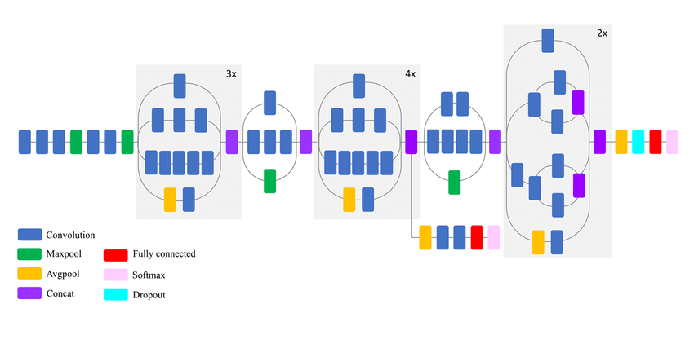
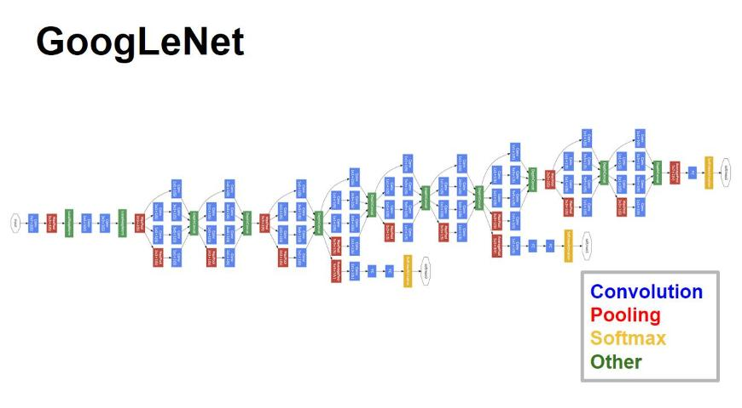
Deep Learning and AlexNet
Deep Learning Basic Framework
Data Acquisition & Preprocessing
Predicted Output
Model
Supervised Learning
Unsupervised Learning
Inception V3
AlexNet
GoogleNet
Notes:
大小写

Slide 7
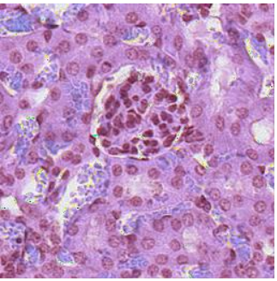
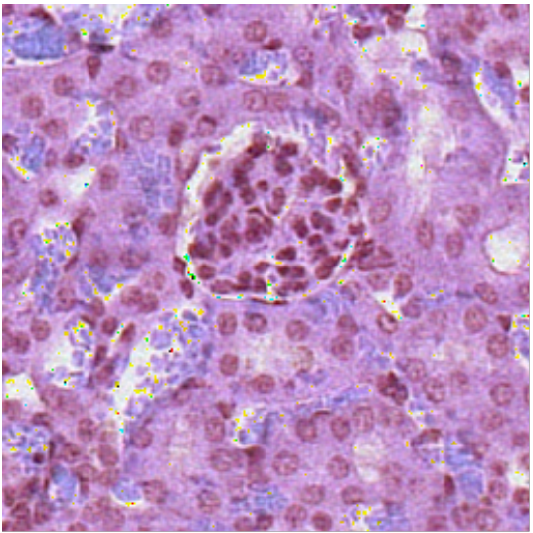
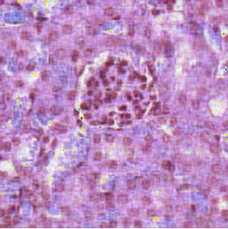
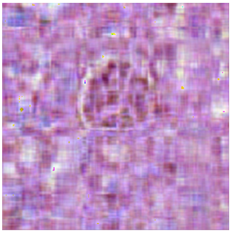
Principle Component Analysis (PCA)
- Dimensionally reduce the redundant information in the image
- Compress the image to shorten the training time for AlexNet
100
60
30
10
With 100 principal component (PCs), the image preserved most of its features
With more 100 PCs, no significant features were added

Slide 8
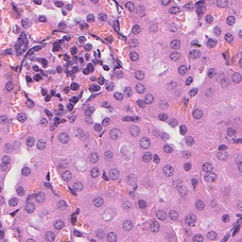
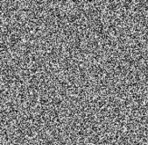
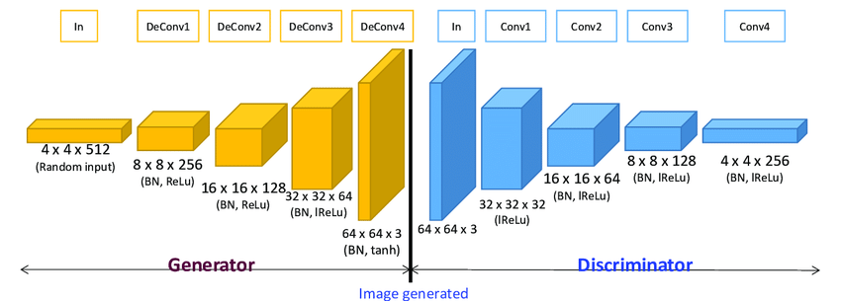
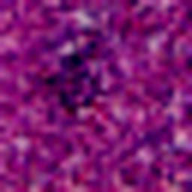
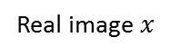
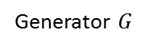
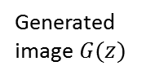
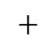
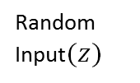

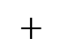
Deep Convolutional Generative Adversarial Network (DCGAN)
Random Input$(z)$
Real image $x$
Random Noise
Discriminator $D$
$$+$$
Predicted Result
1
0
Training Process
Generated image $G(z)$
$$+$$
AlexNet
Generator $G$

Slide 9
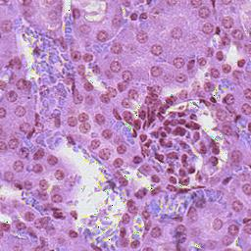
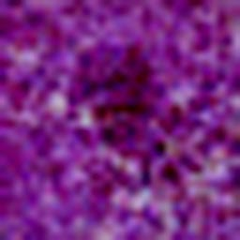
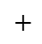

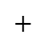

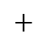
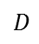
Combination of GAN and PCA
DCGAN + PCA
Principle Component Analysis (PCA)
$$+$$
Highlight important feature might accelerate the learning process
$$G$$
$D$
Deep Convolutional Generative adversarial network (DCGAN)
- Simplified information allows easy capture of important features
- Large number of similar ensures sufficient information is provided
$$+$$
Provide extra images for network to learn
Training Process
$$G$$
$D$
$$+$$
AlexNet

Slide 10

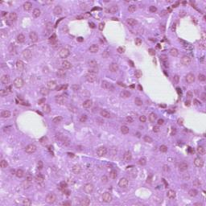
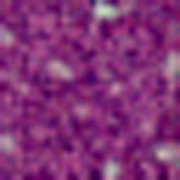
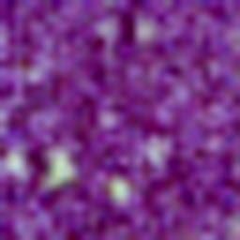
Preprocessed Images
PCA
Reconstructed Image
GAN
Generated Image
GAN Generated
PCA Reconstructed Image
Original
Flipped

Slide 11
AlexNet with Preprocessed Datasets (Result)
The accuracy of the model with any version of datasets increases along with the training epochs.
Data processed with data extension achieves relatively high accuracy.
Despite Flipped dataset obtained the best result, its application is limited while using GAN is stable and still can get high accuracy.
Compared with classification by manifold learning methods, training a classifier with GAN and PCA preprocessed dataset is superior.
Notes:
Uv 266

Slide 12
Conclusion
Tested 3 different methods of manifold learning to visualize all the data.
Utilized AlexNet for the classification of kidney tissues that contain glomerulus in histological images in conjunction with the reconstruction by PCA and generation by DCGAN.
The classification result validates the hypothesis that preprocessed data can improve the training of the classifier

Slide 13
Thank You

Slide 14
Result
Notes:
Uv 266

Slide 15
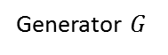
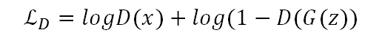
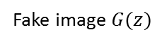

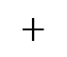
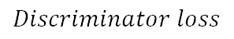
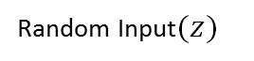
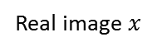
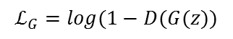
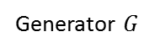
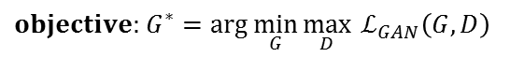
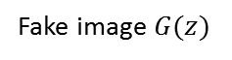
Generative Adversarial Network (GAN)
Generative adversarial network (GAN)
Predicted Result
Random Input$(z)$
Real image $x$
1
$$Discriminator loss$$
$$ℒ_{D}=logD(x)+log⁡(1−D(G(z))$$
Discriminator $D$
Generator $G$
Fake image $G(z)$
0
$$Generator loss$$
$$ℒ_{G}=log⁡(1−D(G(z))$$
$objective:$ $G^{∗}=\arg{\min_{G}{\max_{D}{{ ℒ}_{GAN}\left(G,D\right)}}}$
Deep Convolutional Generative adversarial network (DCGAN)
Random Noise
Predicted Result
$$+$$
Random Input$(z)$
Real image $x$
1
Discriminator $D$
Generator $G$
Fake image $G(z)$
0
I. Goodfellow, J. Pouget-Abadie et al. Generative adversarial nets. (2014)

